Slide 1

Development of machine learning models to process Electronic Health Records – Explainable Models
Week 5 Meeting, 1/11/2021

Slide 2
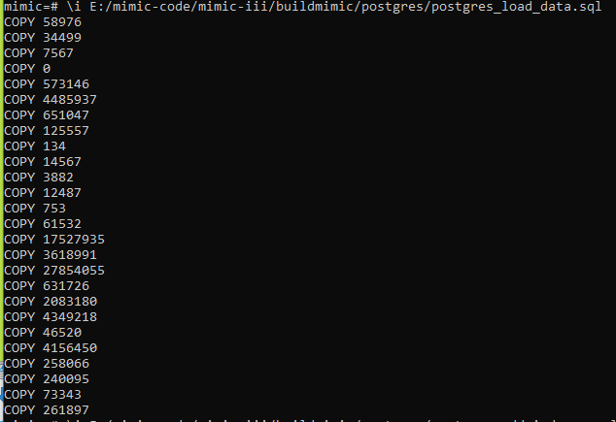
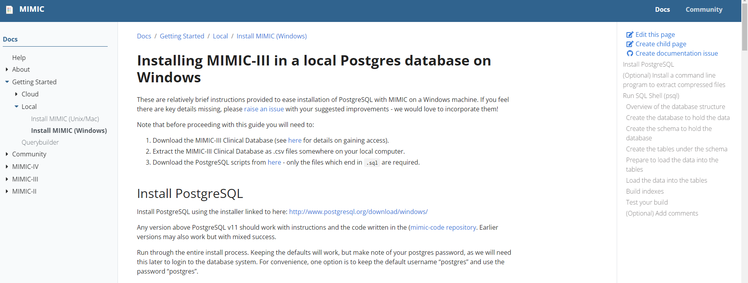
Installed mimic on windows successfully
https://mimic.mit.edu/docs/gettingstarted/local/install-mimic-locally-windows/

Slide 3
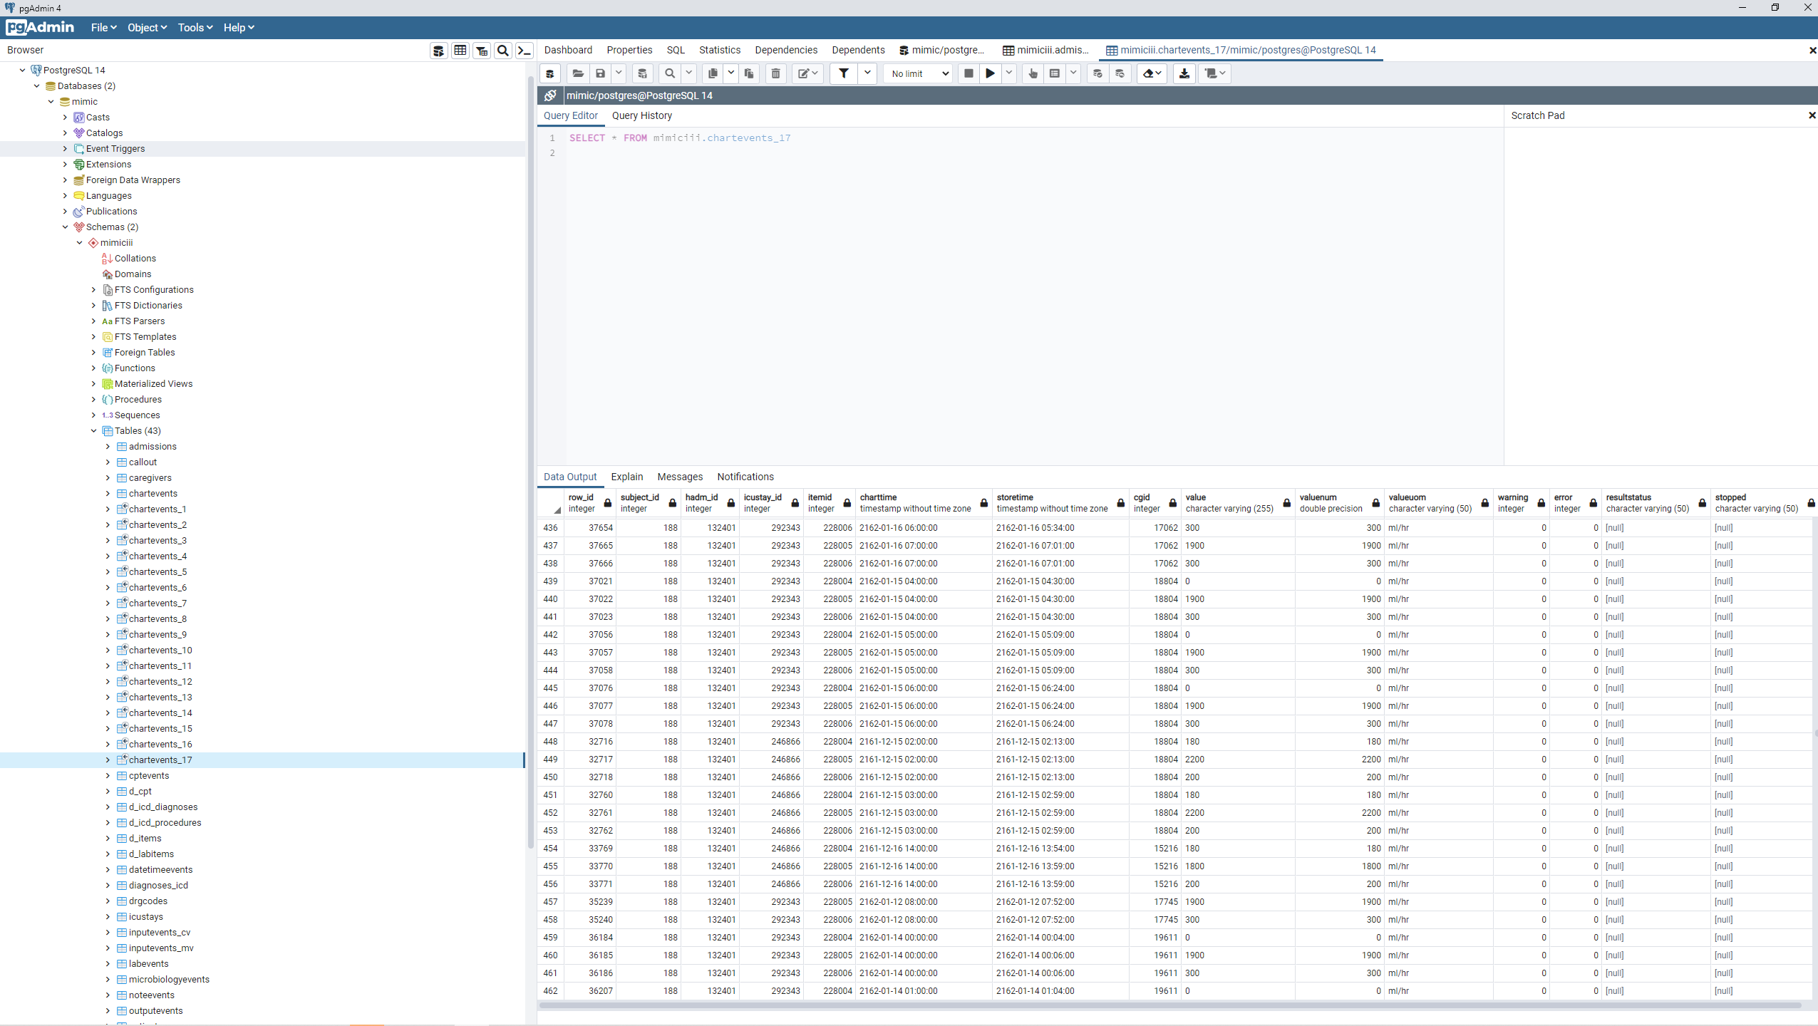
View data on PGADMIN4

Slide 4
Proposal: Train a machine learning model to predict Mortality rate given features from health record
Features (x):
1. ICU stay days
2. Reason of ICU stay (null if 0 day stays)
3. Age
4. Gender
4. Heart rate
5. Height
Label (y):
Mortality of patient

Slide 5
Extract Data for Machine Learning
1. Extract the data for the features from the database
2. Group up the data into a single pandas array
3. split the pandas array into train validation test set
Training the model
1. Train the model using different methods (ex. Linear regression)
2. Train and combine the features
3. Note the effectiveness of each feature (ex. by Analysing covariance matrix)
4. Compare the performance of models by f1 score
5. Principal component analysis to visualize the results
6. Select the final model

